Slide 1
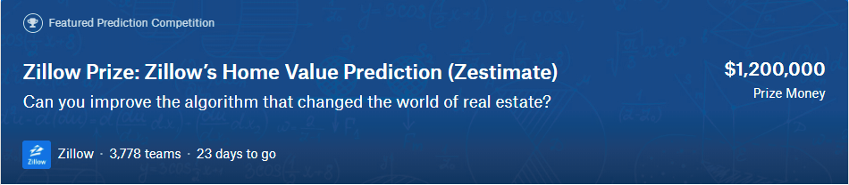
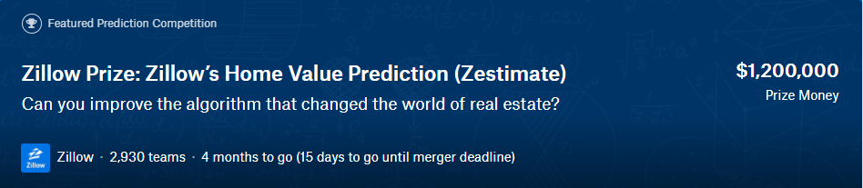
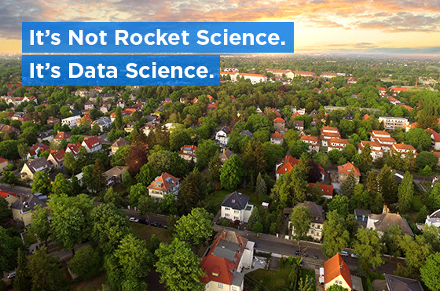
Zillow Prize Competition (first round)
Mohammad Rahimi
1/9/2018

Slide 2
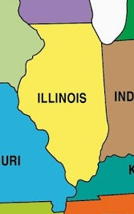
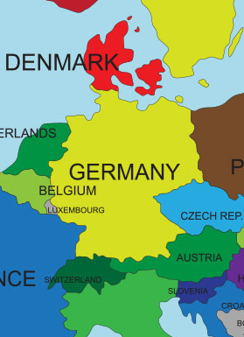

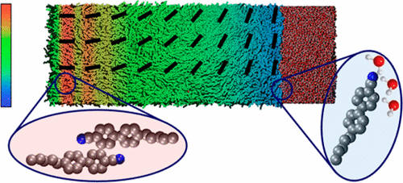
Detect and track physical phenomena with extreme detail-literally on scales where the motion of individual atoms can be tracked

Slide 3






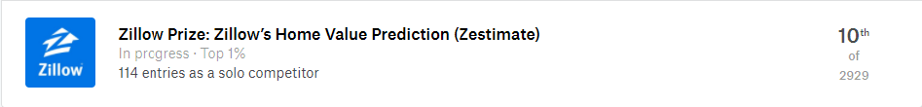
kaggle
A competition with a $1,200,000 grand prize to improve automated home valuations of 110 million homes across the U.S.
Two rounds:
qualifying round
private round for the 100 top qualifying teams
Notes:
Zillow has challenged the data science community to improve the accuracy of Zestimate through a $1,200,000 competition. The competition has been administrated by Kaggle into two rounds: the qualifying round and the private round for the 100 top qualifying teams.

Slide 4
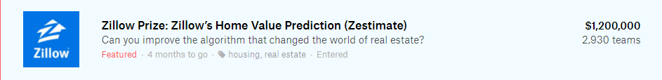
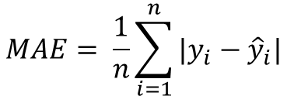
Prediction
$$logerror=\log\left(Zestimate\right)−log⁡(SalePrize)$$
Evaluation
$$MAE= \frac{1}{n}\sum_{i=1}^{n}{|y_{i}−{\hat{y}}_{i}|}$$
Timeline and Dataset
Start
I started
2017 data
Deadline
Winners
May 24
Aug 23
Oct 2
Oct 16
Jan 15
Test
2016 training data
2017 training data
Test
Jan
2016
Oct
2016
Jan
2017
Oct
2017
Dec
2017
The 2016 training data set contains 57 features and 90275 observations.
Notes:
During the first round of the competition, the goal was to predict the Zestimate’s residual error:
to calculate the scores on the Kaggle’s public leaderboard.

Slide 5

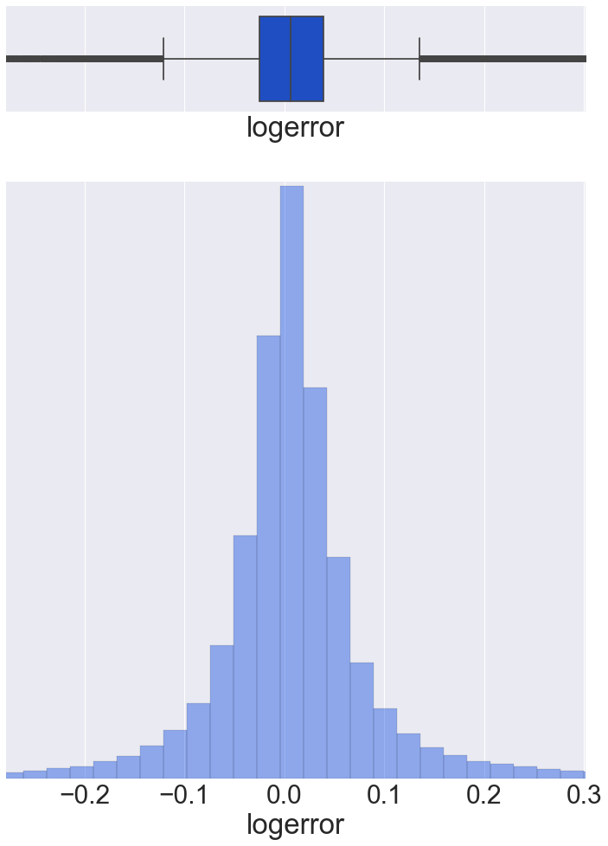
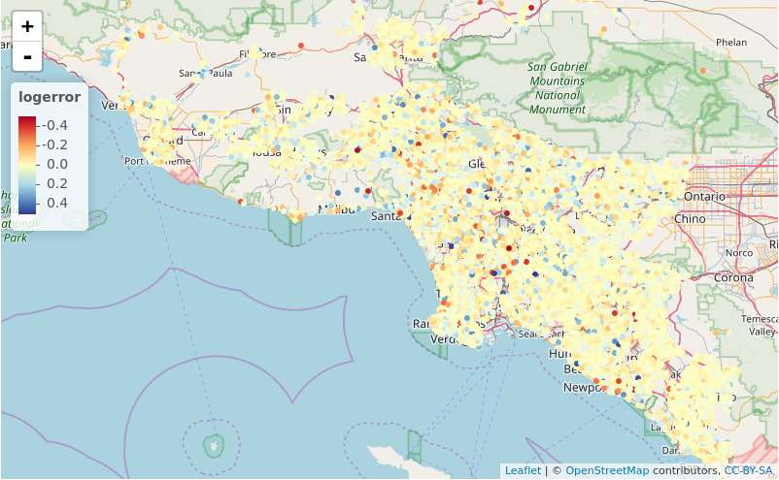
Logerror
$$logerror=\log\left(Zestimate\right)−log⁡(SalePrize)$$
Los Angeles, Orange, and Ventura
Mean | Median
0.011457 | 0.006000
Notes:
The distribution of logerror is normal with a positive mean and median. This indicates that Zestimate, in general, tends to overestimate the actual sale price of the properties.

Slide 6
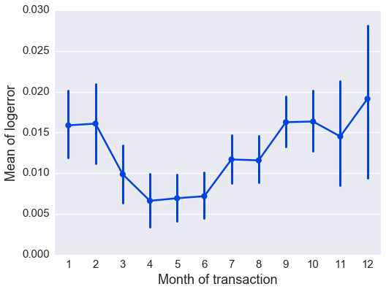
Logerror
$$logerror=\log\left(Zestimate\right)−log⁡(SalePrize)$$
Mean | Median
0.011457 | 0.006000
Notes:
The average logerror decreases as we enter the spring (March, April, etc) and it rises once the summer is over (September, October, etc). This may signal a general and possibly a periodic trend.

Slide 7
Features
The training data set contains 57 features and I classify them into 5 categories.
Location | Area/Size | Number | Quality | Tax
latitude | area_firstfloor_finished | num_bathroom | type_aircon | tax_building
longitude | area_total_calc | num_bedroom | type_architectural | tax_total
region_city | area_live_finished | num_bathroom_calc | type_framing | tax_year
region_county | area_liveperi_finished | num_fireplace | type_quality | tax_land
region_neighbor | area_total_finished | num_bath | type_deck | tax_property
region_zip | area_unknown | num_garage | type_heating | tax_delinquency
zoning_property | area_base | num_pool | pooltypeid10 | tax_delinquency_year
zoning_landuse_county | area_basement | num_room | pooltypeid2
fips | area_garage | num_75_bath | pooltypeid7
censustractandblock | area_pool | num_unit | type_story
rawcensustractandblock | area_lot | num_story | build_year
 | area_patio |  | type_material
 | area_shed |  | flag_tub
 |  |  | flag_firepalce
 |  |  | type_zoning_landuse
Notes:
we have renamed the features for easier interpretation of their contents

Slide 8
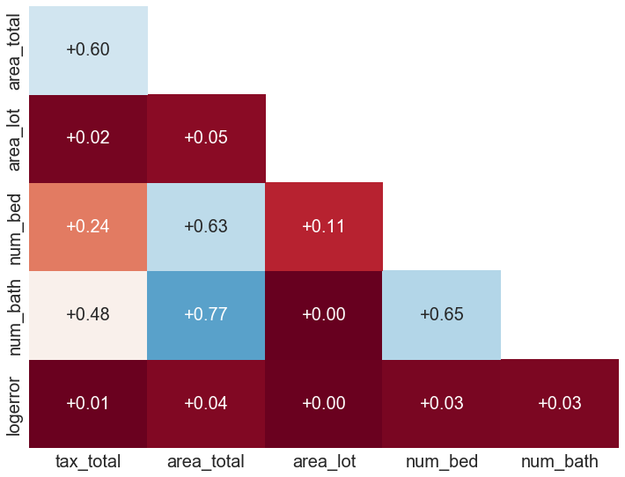
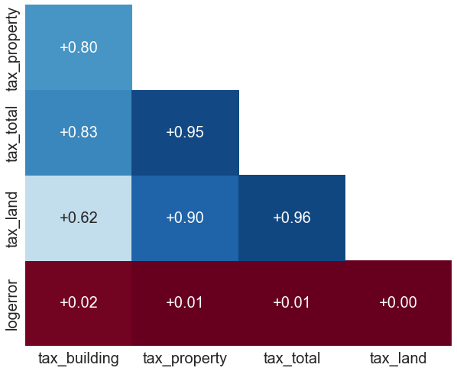
Correlation between features

Slide 9
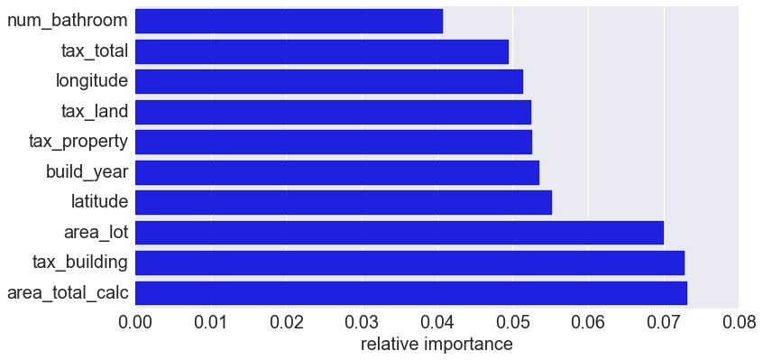
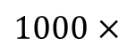
XGBoost (Extreme Gradient Boosting)
XGBoost provides a parallel tree boosting (also known as GBDT, GBM) that solves supervised learning problems in a fast and accurate way. XGB is highly effective, and widely used in data science problems.
High Flexibility
Handling Missing Values
Regularization
Tree Pruning
Built-in Cross-Validation
Parallel Processing
Learning parameters | Overfitting parameters
Learning rate | Sample fraction
Max depth | Columns fraction
Number of round | L1 and L2 regularization
Score with logerror outliers | Score without logerror outliers
0.0655127 | 0.0645248
65.5127 | 64.5248
Leaderboard Score
0.0655127
65.5127
$1000$ $×$

Slide 10
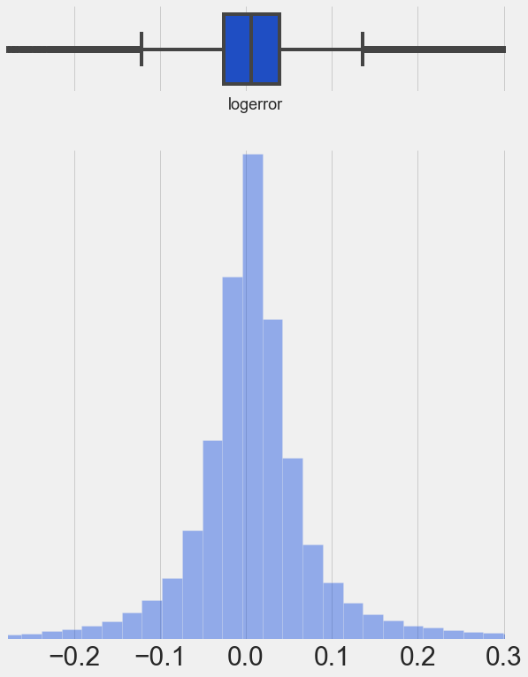
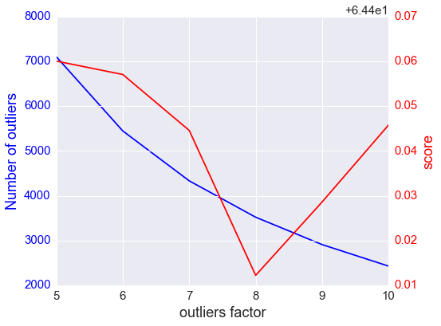
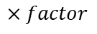
Outliers
$$logerror=\log\left(Zestimate\right)−log⁡(SalePrize)$$
Min | 1th quartile | Median (mean) | 3th quartile | Max
-4.605 | -0.0253 | 0.006000 (0.011457) | 0.0392 | 4.737
1q
3q
$$×factor$$

Slide 11
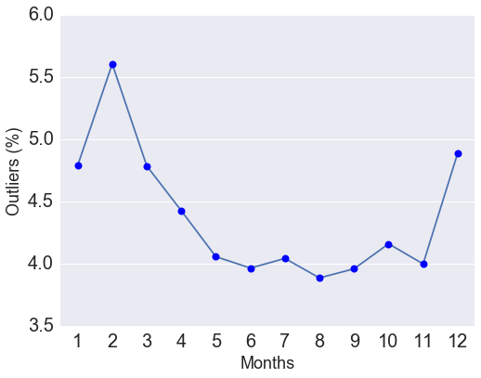
Outliers
1q
3q
$$×factor$$

Slide 12
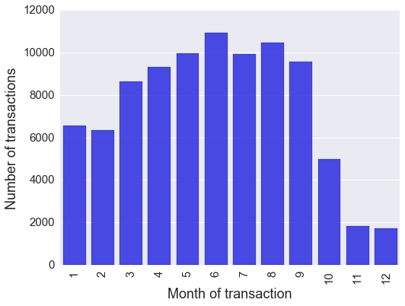
Evaluation
Kaggle evaluation
Reserves a test data set for evaluation and calculates leaderboard (LB) score
Limited to 5 submissions per day
Test
2016 training data
Jan
2016
Oct
2016
Jan
2017
Local evaluation
Split the data set based on the month
Train
Test
9 months
3 months
LB score | 3Month score
64.5248 | 64.9093
Notes:
needs to create a local cross-validation system that corresponds well to the computed score on the leaderboard.
Kaggle has reserved nearly 2/3 of the logerror data for the time-period October-December 2016 to compute the public leaderboard, we used the remaining data for that time-period for local validation of our models.

Slide 13
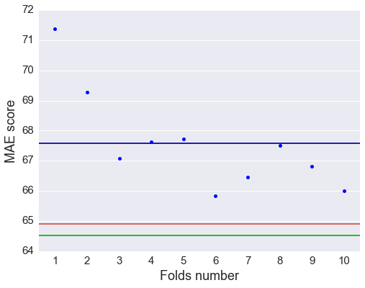
Cross-Validation
Training data
1
10
Train
Test
CV score
Drop outliers
3Months score
LB score
Train model
Evaluation

Slide 14
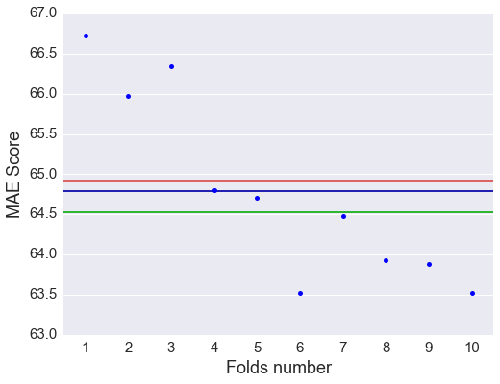
Cross-Validation
Training data
1
10
Train
Test
3Months score
CV score
Drop outliers
LB score
Drop outliers
Fac=65
Train model
Evaluation
Notes:
The CV score obtained by dropping the outliers closely tracks the LB score on Kaggle’s website.

Slide 15
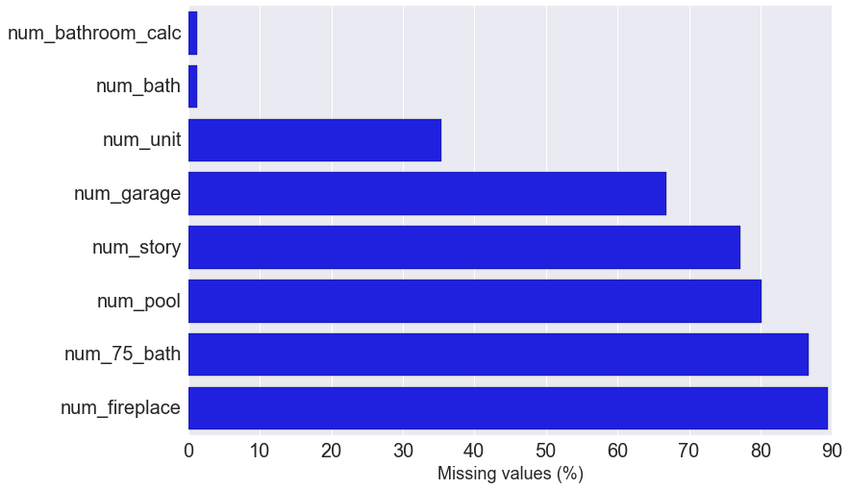
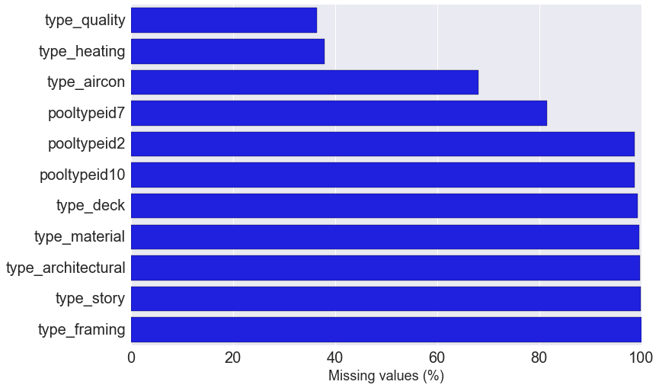
Missing values
Missing values in number features
Missing values in quality features
Replace the missing values with zero
Group the missing values into a new category

Slide 16
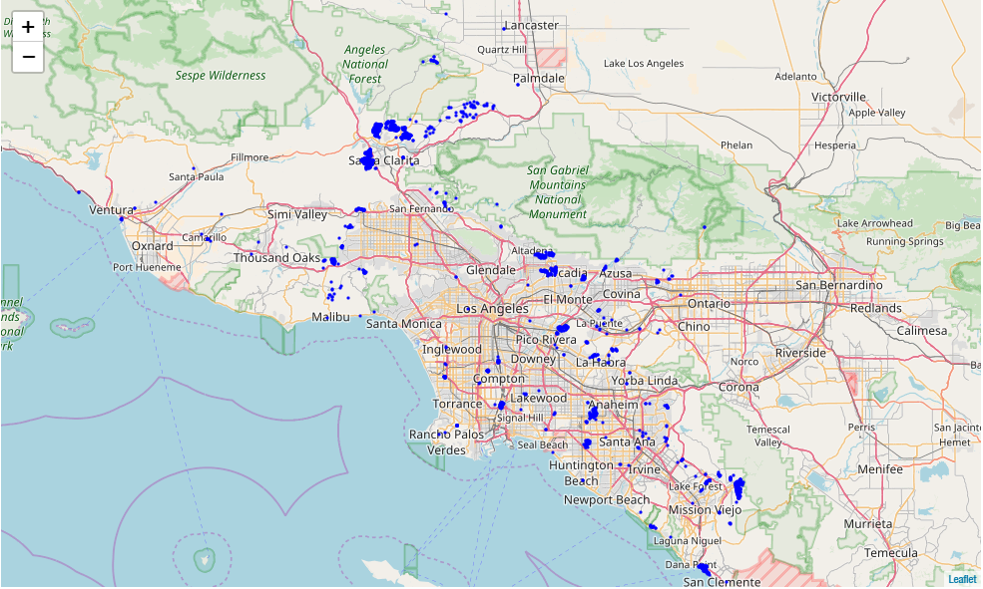
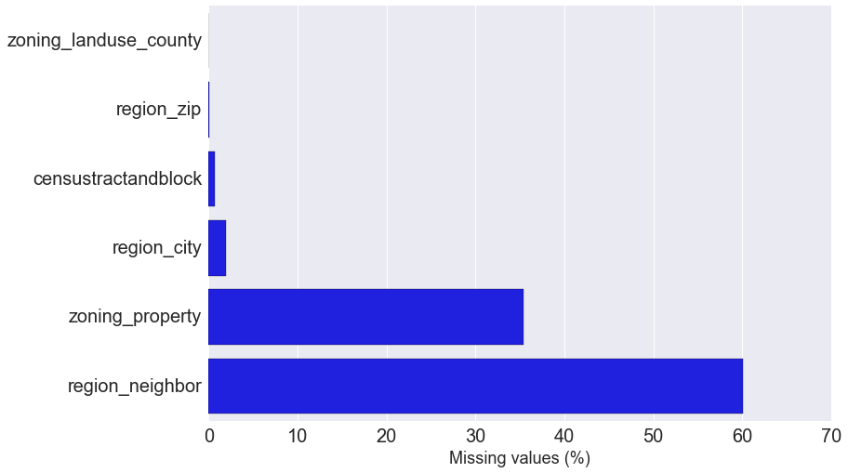
Impute missing value
Missing values in location features
Latitude and longitude are used to impute the missing values in location features
Location of missing region_city values on a map
Notes:
we used the coordinates (longitude and latitude) of a property to replace the missing values. The problem then turned into a k-nearest neighbor classification problem. For a property with a missing location feature, we identified the nearest 100 neighbors on the map to determine the missing location value.

Slide 17
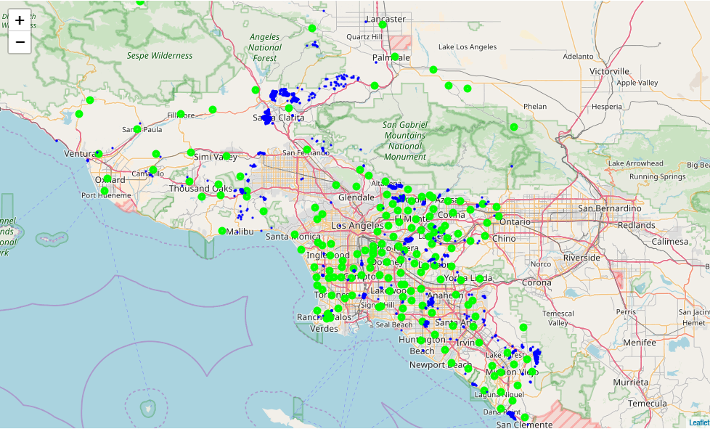
Impute missing value
Missing values in location features
Assign each missing point to the closest region_city center.
The data set contains 177 region_city shown with green circle on the map. The blue points show the location of missing value

Slide 18
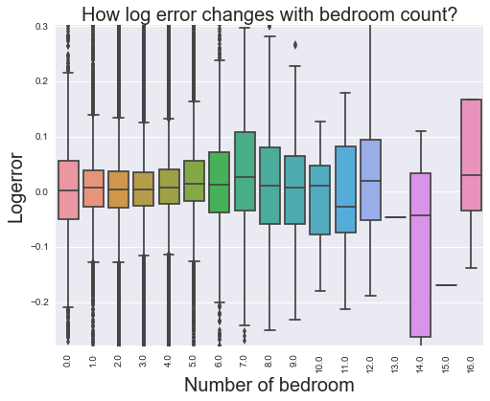
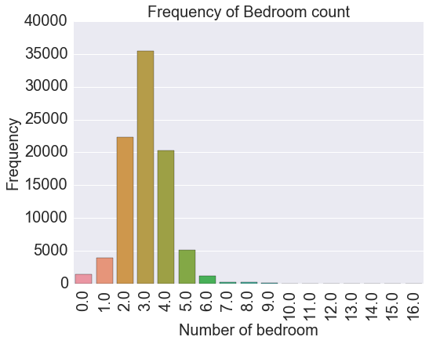
Rare events
Combine the events with low frequency in one group to avoid overfitting

Slide 19
Feature engineering
Feature engineering is the process of using domain knowledge to create features that improve the performance of prediction models. It is the key to success in applied machine learning.
Create new features
Number of missing value in each row
Count the number of homes in each county, city, and zip code
Combine the features
area_lot / area_total; area_live / area_total
Tax_land / tax_total
Num_bath / num_bedroom
Tax / area
Area / num_bedroom
Before FE | After FE | Improvement
64.4122 | 64.3953 | 0.0169
Transfer data to other coordinates or spaces
Transfer the latitude and longitude to polar coordinate
Rotate the Cartesian coordinate
Notes:
Feature engineering is exceptionally important in making successful predictive models. Feature Engineering is an Art.
The implementation process in this project involved an iteration between two main steps:
1- Feature engineering
2- Model training and testing

Slide 20
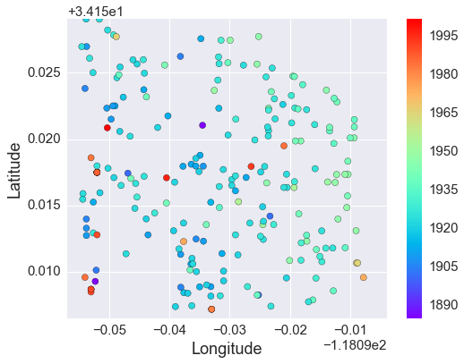
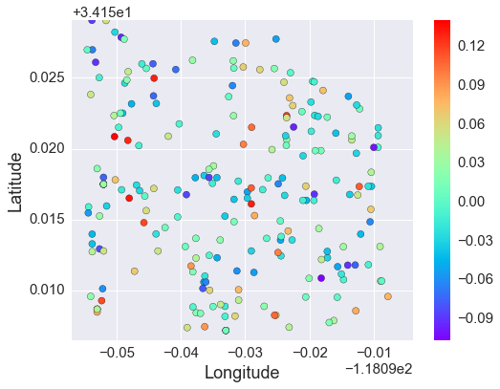
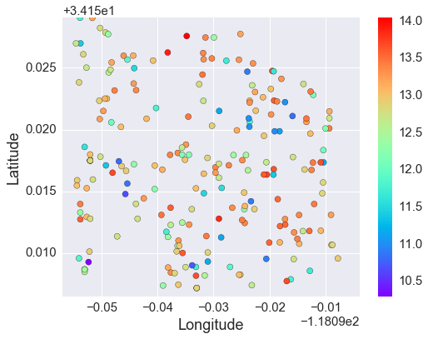
Feature engineering
Homes in zip code 96292
Year
Homes in zip code 96292
logerror
Calculate the mean value of most important numerical features in each city and zip code
Compute the deviation of the features from mean value in city and zip code
Log(tax)
Before FE | After FE | Improvement
64.3953 | 64.2911 | 0.1042
Notes:
We hypothesized that Zestimate uses the sales values of the nearby properties to make predictions about the future sales prices of a certain property.

Slide 21
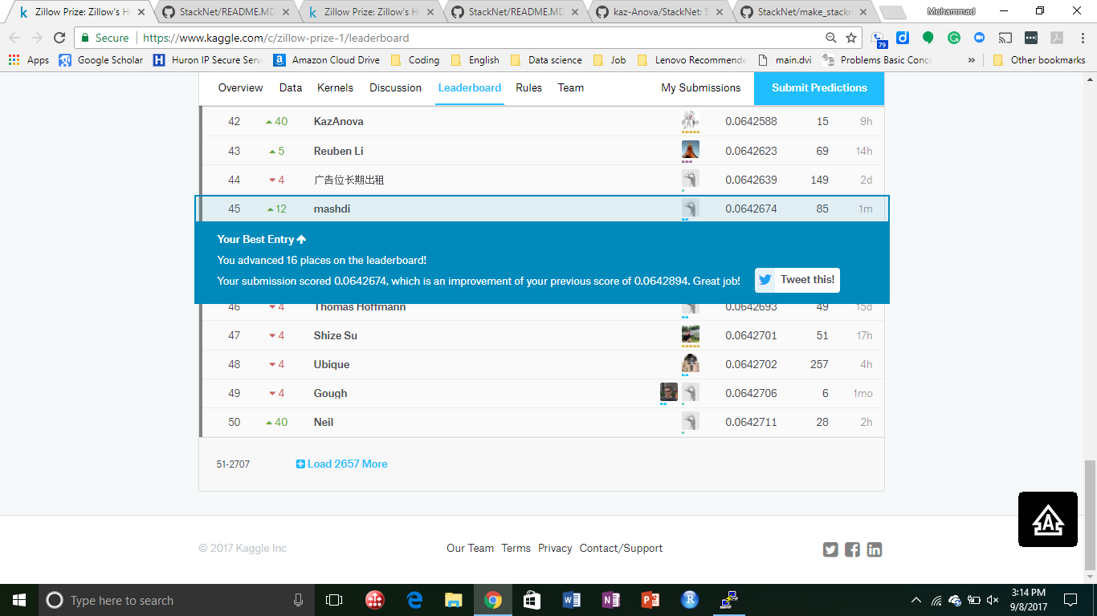
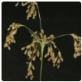


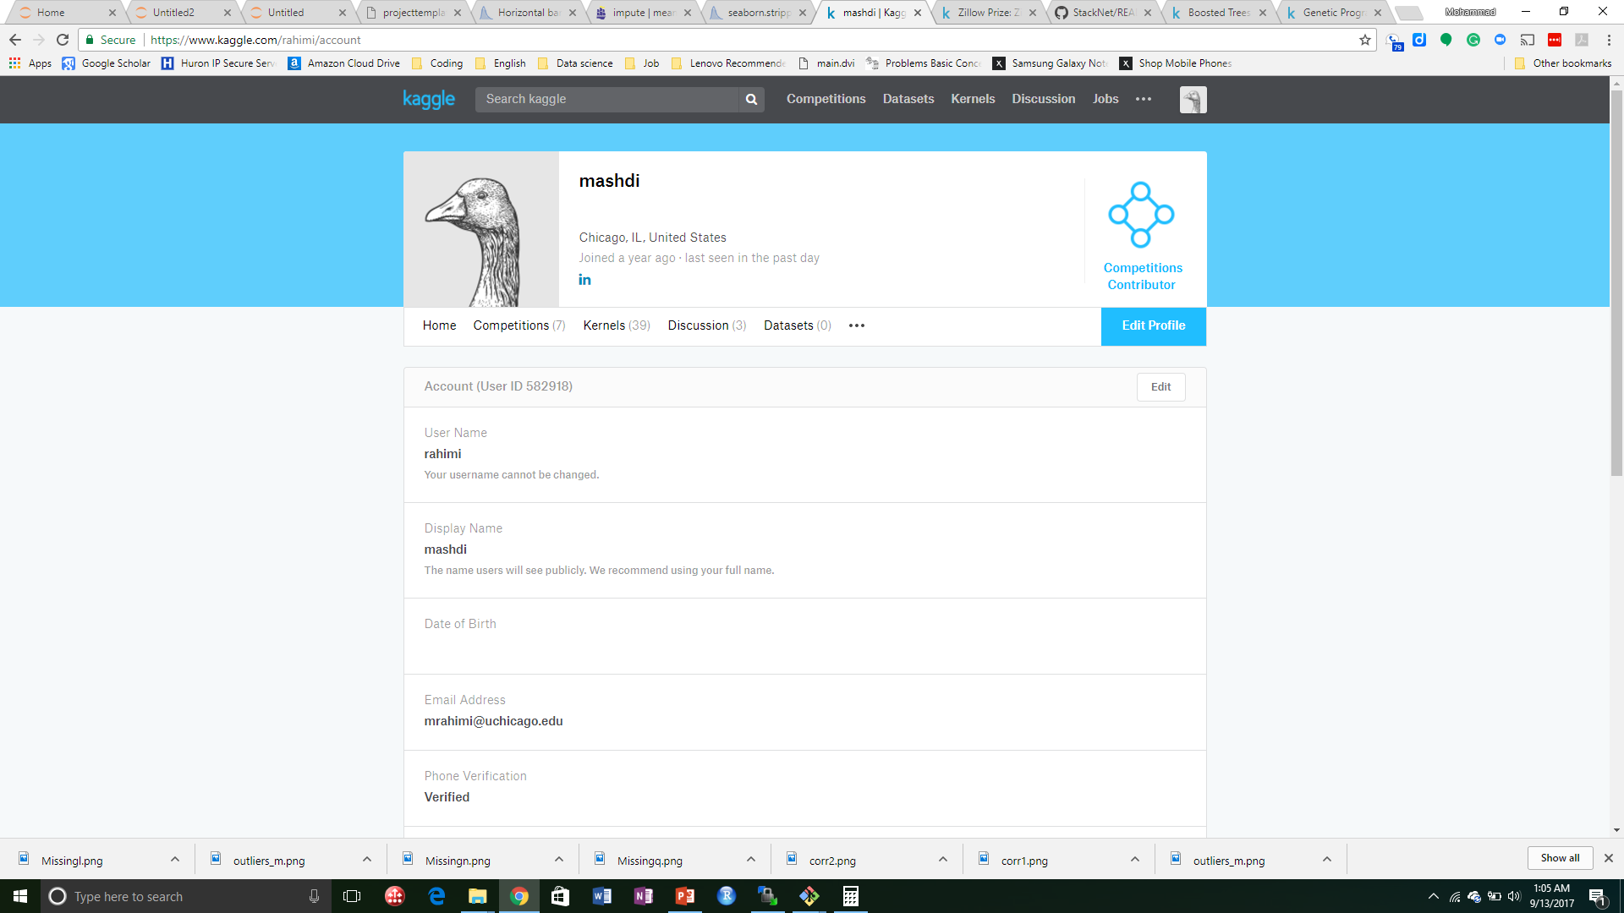
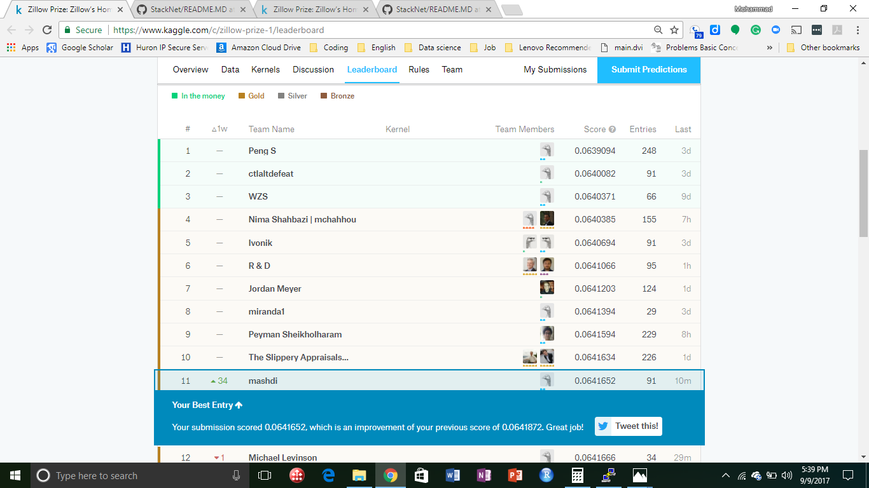
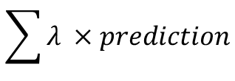
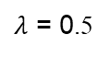
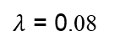
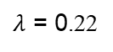
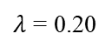
Combine models
64.39
64.37
64.33
64.26
$$\sum{λ ×prediction}$$
$λ$ = 0.20
$λ$ = 0.22
$λ$ = 0.08
$λ$ = 0.5

Slide 22
Feature engineering
Homes in zip code 96292
Year
Homes in zip code 96292
logerror
Calculate the average over k nearest neighbors for each property and compute the difference between mean and actual value
Optimize the k value (k=50)
Log(tax)
Before FE | After FE | Improvement
64.2674 | 64.1472 | 0.1202

Slide 23
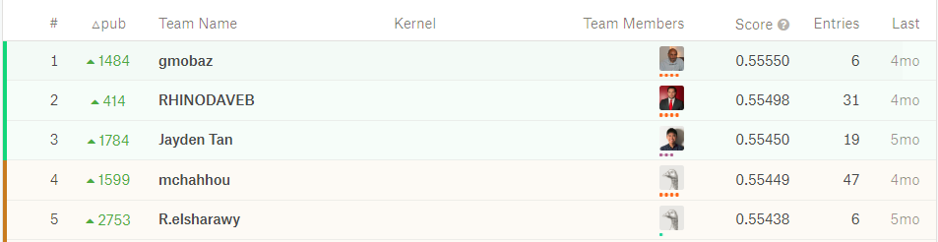
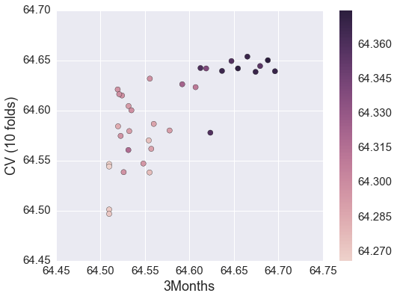
Kaggle competition or gambling
The final leaderboard score is calculated only for two selected submission
LB score
Notes:
‘K’aggle should be capitalized or not?

Slide 24
Ensemble methods
Stacked model
Model 1
Model 2
Combine 1
Model 3
Prediction
Combine 2
Model N

Slide 25
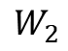
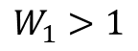
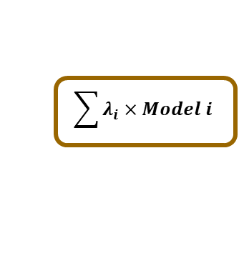
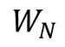
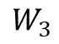
Ensemble methods
Stacked model !!!
Combine models
Model 1
$$W_{1}>1$$
W1×Model 1
Model 2
$$W_{2}$$
W2×Model 2
Model 3
$$W_{3}$$
W3×Model 3
$$\sum{λ_{i}×Model i}$$
Model N
$$W_{N}$$
WN×Model N

Slide 26
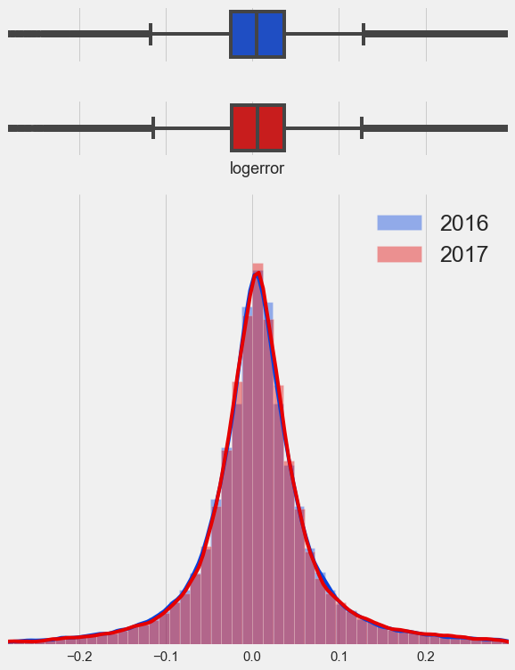

Train 2017
 | Mean | Median
2016 | 0.011457 | 0.006000
2017 | 0.016755 | 0.006670
2017 training data
Test
Jan
Aug
Sep
Notes:
The main difference between "properties_2016" and "properties_2017" are in tax features.
feature engineering process is largely independent of the time period that the data was collected,

Slide 27

Evaluation of 2016

Slide 28


Evaluation of 2017
October 2017
November 2017
Thank you for your attention

Slide 29


Slide 30

Explore the data
duplication

Slide 31
Stacking
Stacking is an ensemble technique used to combine information from multiple predictive models to generate a new model. The stacked model outperforms each of the individual models since it combines the strength of different models. For this reason, stacking is most effective when the base models are significantly different.
Model 1
Model 2
Model 1
Model 3
Data
Prediction
Model 2
Model N

Slide 32
Run a model in a node
Model
5
5
4
4
Model
Train data set
3
3
Concat
New feature
2
2
1
1
Prediction
Test
Prediction
Average

Slide 33
Combine predictions
Model 1
Model 2
Model 3
Data
Model 3
Model 1
Model N
Model 2
Model N

Slide 34
Future work
Do more feature engineering
Optimize the number of clusters for k-mean
Transfer the numerical variable using PCA or ICA
Tailored clustering based on radial distribution function
Handle repeated transactions
Implement stacking model

Slide 35
Ensemble methods
Stacked model !!!
“The meta features in {fold2, fold3, fold4, fold5} are dependent on the target values in fold1. So, the target values we’re trying to predict are themselves embedded into the features we’re using to fit our model. This is leakage and in theory S (first model) could deduce information about the target values from the meta features in a way that would cause it to overfit the training data and not generalize well to out-of-bag samples.”
http://blog.kaggle.com/2016/12/27/a-kagglers-guide-to-model-stacking-in-practice/

Slide 36



Feature engineering using k-mean
The center of 177 cites shown on the map
20
100
170
220
290
470
390
The center of 170 clusters made by k-mean
Calculate the mean value and the deviation from mean value each cluster defined by k-mean
Before FE | After FE | Improvement
64.2911 | 64.2674 | 0.0637

